Slide 1


Simple Billing System
Summer Training Program for MCA
By
Shriyansh Shukla
323102774
Lovely Professional University

Slide 2
Introduction
This Billing System is developed to automate the billing process for small businesses and restaurants. It aims to reduce human errors, save time and provide an easy to use user interface for generating bills. The system calculates total items prices applies taxes in them and then generates a receipt.

Slide 3
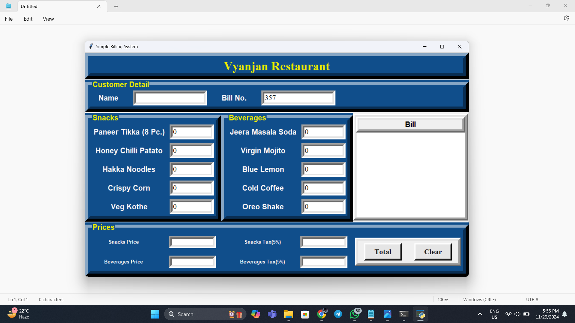
Automatic Bill Number Generation
The system generates a unique bill number so every transaction is identified uniquely.

Slide 4

Customer Details Input
The system captures customer detail which include name so it can maintain accurate record.

Slide 5
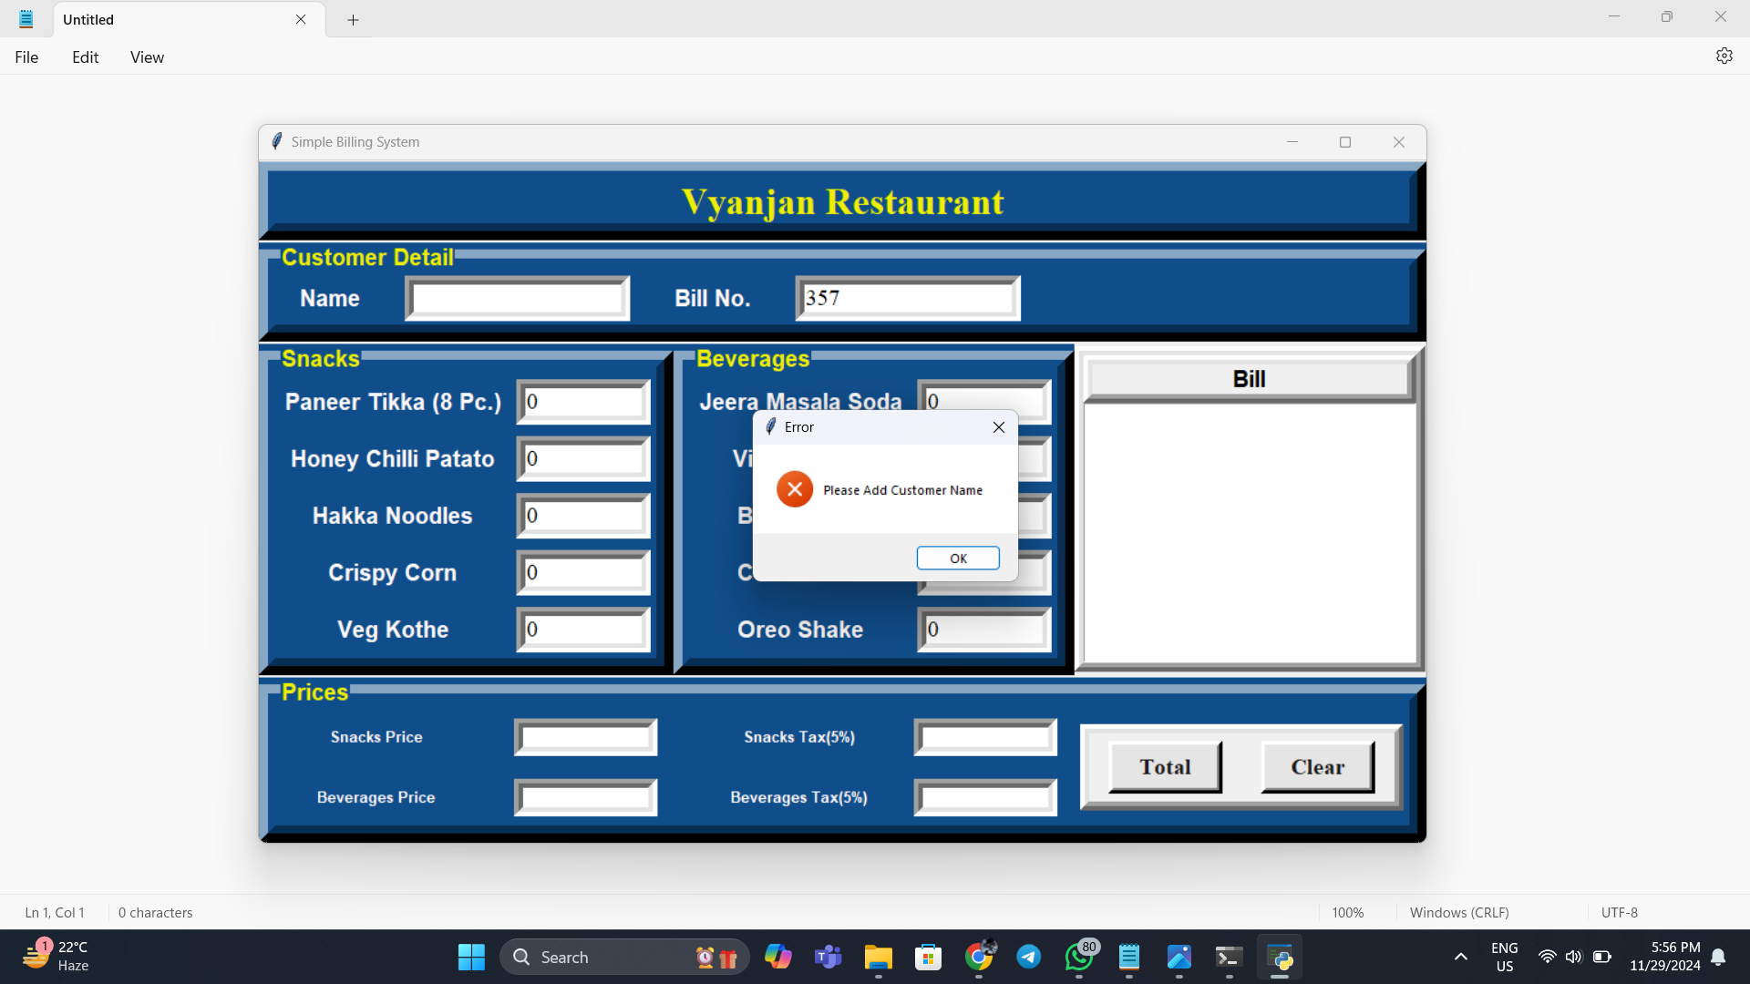
Error Handling
If the customer name is not entered the system displays an error message to prevent incomplete bill.

Slide 6

Menu Items
We can input quantities for menu items like snacks and beverages which are used to calculate taxes and total bill amount.

Slide 7

Bill Generation
The system calculates items prices, taxes, final total amount and displays a bill after clicking the onTotal button.

Slide 8

Clear Functionality
The Clear button resets all fields so a new order can be entered quickly and easily.

Slide 9
Features and Benefits
The Billing System is designed to automate crucial billing processes such as providing fast and accurate calculations and generating bills in real time. It also applies taxes automatically and offers an easy to use interface which significantly decrease the possibility of human error. All of these features improve transaction efficiency and customer satisfaction.

Slide 10
Thank You
Thank you for your attention!
Please feel free to ask any questions.

